Slide 1
Medial EarlySign – Short Introduction
Medial EarlySign, Jul 2021

Slide 2
Derive Extraordinary Clinical Insights From Ordinary Clinical Data To improve Early Detection and Prevention
Mission
Data Driven Medicine
GI Disorders )e.g. CRC)
Renal Failure
Diabetes
Notes:
Bring to light “hidden” information within existing medical data.
Building decision support tools for personalized risk assessment of life threatening conditions.

Slide 3
AlgoMarkersTM – Machine Learning Clinical Predictors
An AlgoMarker targets a specific population
and identifies a sub-population
In which a specific clinical condition is likely
Notes:
A big domain and a Big opportunity to help
Only a cheap approach can scale for masses world wide
People are falling between the cracks while simple and cheap tests are accessible the new generation of solutions will be available to the masses at prices that population health could afford only in 25 years from now.

Slide 4




LGI Flag - a Computed Relative Risk Indicator
Based on:
Standard CBC values
Age
Gender
Identifies trends and variations within the normal ranges as well as exceptions from the norm
Looks far beyond anemia, and identifies patterns that humans cannot
LGI Flag
Red Flag
No Flag
Score
Expedited
Assessment
Follow Guidelines
Notes:
Option 2

Slide 5
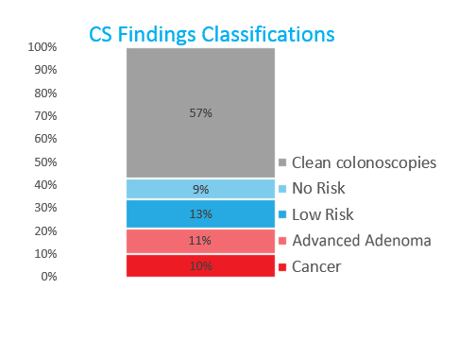
Maccabi Healthcare Implementation LGIFlag
Colonoscopy Findings
(~700 colonoscopies in 3 years)
1:10 diagnosed with CRC
1:9 diagnosed with high risk adenomas
Any kind of findings >40%
1:500 CRC diagnosed without the score

Slide 6
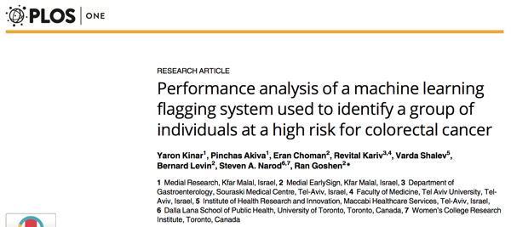
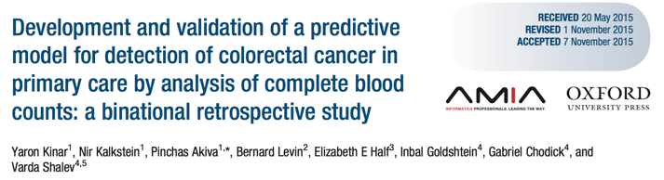
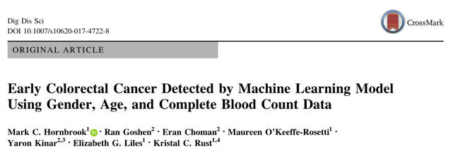

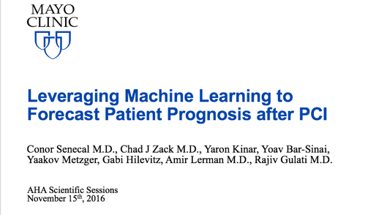


Clinical Rigor

Slide 7
CMS AI health outcomes Challenge
CMS AI health outcomes challenge on unplanned admissions, adverse events
More then 300 companies: IBM, Columbia university, Mayo Clinic…
Several rounds: developed 18 different models
Performance: discrimination, calibration
Explainability – explanation reports for physician's judgement
Bias Analysis – fairness between different sub-populations
Finished as runners up !

Slide 8


Typical Medical Record
Demographics
Lab Tests
Diagnosis
Drugs
Procedures
Textual Summaries

Slide 9

MEDICAL RECORDS ARE A MESS!
Notes:
Investor/Strategic Partner Deck

Slide 10
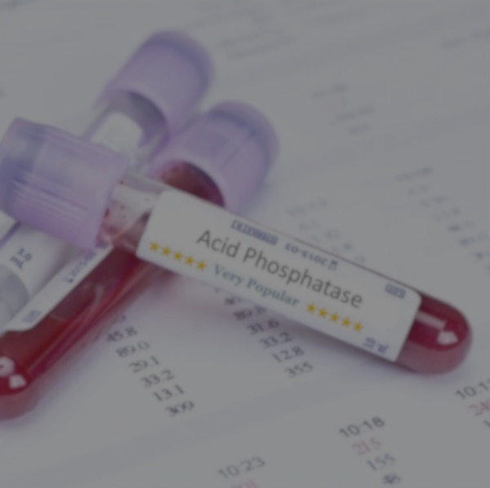
Imaging
Medical records

Slide 11
Birdseye Development Platform view
Data Repository
Unification
High performance
Training Infrastructure
Deal with time dimension
Configurable
Matrix Generation
Training and Analysis
Production Infrastructure
AlgoMarkers
Easy productization
On prem Sandboxes
Software wrappers (Apps, Python)
Easy setup (Docker)
Efficiency

Slide 12
Data Model – Major Needs
Unified
Data repository
Memory Efficient
Common API for:
Demographics/Lab/Medication, etc.
Inpatient/Outpatient
Different data sources normalized at loading
Feasible with a single computer
Minimize disk access
Fast
Cluster extendable for richer data sources (Omics, Continuous Signals)
Basic Operation: get all events of a given signal per patient sorted by time
Increased number of cycles = better chance to improve performance

Slide 13
Methodology
Model construction: Modular, C++ libraries, python APIs
Data Preparation
Model Generation
Data Model: Unified, efficient in time and memory
Internal Validation & Analysis
External Validation
Datasets
Importing, Organization, Normalization, Ontologies
Cohort Preparation
Selecting population, Sampling, Labeling
Repository Processors
Outliers, Enrichment
Feature Generators
Moments, Trends, Embedding, Encoders
Feature Processors
Imputation, Feature Selection
Predictors
Regression, Trees, Boosting, Neural-Nets
Post-Process
Recalibration, Interpretation
Internal Validation
Performance analysis, Bootstraping
AlgoAnalyzer
Model Export
(Blind) External Validation
Notes:
Option 1

Slide 14
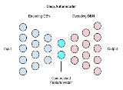
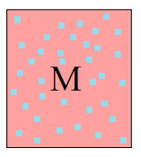
The Journey
Data Repository
Cleaning
Feature Generation
Imputation
Modeling
Performance
RF
Bootstrap
Analysis
GBM
Bootstrap
Analysis
NN
Bootstrap
Analysis
Stack
Bootstrap
Analysis

Slide 15

Deciphering the black box
Feature Importance:
Group statistics : Which features/signals gave the most information on average
On the train population
On a selected test population
ButWhy:
Individual : Which features were important for a specific patient
Why did this specific patient get a high or low score?

Slide 16

Development Environments
Medial
Client
Data Center
20M+ records
100M+ patient years
Data Server
Client Data
Secured
Secured Access
Computing Cluster
Computing Server
Installed with Medial Tools
Repository/Training/Testing/Exporting
Model
+
Client Data
Features
Retrained
Model
Model
Scores
Trained on internal Data
Biological - No “client specific” features
Trained on large datasets
Uses the power of the Internal model
Incorporates client specific data to improve performance

Slide 17
Model Construction – the Complete Picture
A unified language to define and work with ML projects.
Raw Data
Semi Automated
Repository
Optional
Modeling
& Testing
Export as AlgoMarker
Cohort
Train/Test Lists
Configure:
Cleaning
Features
Selection
Normalization
Model
Sampling
Filtering
Matching
Splitting

Slide 18

AlgoAnalyzer™ - A Runtime Flexible Platform
EHR
Care- Management
AlgoMarker A
Payer
AlgoAnalyzer™
AlgoMarker B
DWH
EHR
AlgoMarker C
LIS
Runtime environment for AlgoMarkers™
Data aggregation & normalization
Batch Processing, Reports & Statistics
Cloud or On-Prem
Customizable & supports multiple integration modes
Notes:
- Explain architecture piece by piece
How does this architecture address the problems defined previously?

Slide 19
Customer Ready
Medial’s AlgoMarkers Factory
LGI-Flag
Pre2D-Flag
Lung Cancer
DM to CKD
DM to CAD event
First CAD event
HTN to CKD
Notes:
Earlier more treatable stages.
Routine clinical data. Focusing on tests that majority of patients are likely already have, many health systems have in large quantities. Vs. important work others are doing on genomics, advanced imaging and others AI fields.
Conditions where early detection can make a difference. Intervention that matters.
LGI – 11+ validations studies published. retro publications as well as prospective; several datasets; Labs and basic demographic.
Pre2D – results reproduced on external datasets. Labs and basic demographic, drugs.

Slide 20
Development and Research
Medial’s AlgoMarkers Factory
AAA
Blood Cancer
Asymptomatic Haematuria
Upper GI
Afib appropriate anticoagulation
Flu Complications
PreDM to CKD
and more …
Pre-HTN to HTN
Fatty Liver
Depression Risks and Treatment
CKD to ESRD
Opioid Abuse
Readmission
Notes:
Going after other common high burden conditions, when diagnosing early can make a big difference.
flu – complications. Compliance. 2 prospective studies.

Slide 21
Diabetic CKD AlgoMarker™
The Prediction: Identify diabetic patients (T2D) at high risk for progressing to Diabetic Chronic Kidney Disease (CKD) Stages 2-4 within 3 years, for whom further evaluation and heightened awareness, per current standards of care and guidelines, is warranted.¹
Early Intervention Opportunities: Enhanced patient follow-up and monitoring; early referral to nephrologist; consider potential appropriateness of medication (e.g., avoiding nephrotoxins such as NSAIDs, contrast media, and other nephrotoxic drugs). ²
Potential Outcomes and Advantages: Prevent or delay progression to Diabetic CKD; prevent or delay dialysis or transplant; efficient targeting
¹The Diabetic CKD AlgoMarker™ is a relative risk indicator and is not intended for use in the diagnosis or screening for chronic kidney disease. ²Listed interventions are examples only and should be considered in the context of an individual’s overall health and according to the established clinical guidelines and existing clinical practices.

Slide 22
Diabetic progression to CKD stages 2-4 within 3 years
Model validation results
Cohort: 40–80 year old diabetic patients with normal kidney function
Glucose: 2x >125 mg/dl, or 1x ≥ 200 mg/dl
HbA1C: 1x ≥ 6.5%
Diabetes diagnostic codes
Diabetes drugs prescribed
eGFR ≥ 60
Microalbumin < 30 mg/g
Positivity Rate (%) | 1.0 | 3.0 | 5.0 | 10.0
Sensitivity (%) | 12.3 | 25.5 | 34.6 | 48.7
PPV (%) | 22.3 | 15.4 | 12.6 | 8.8
AUC | 0.813
By flagging the top 3% of a diabetic population at risk, our Diabetic CKD AlgoMarker™ captures 25.5% of diabetic patients likely to progress to CKD within 3 years First retrospective validation study performed on a UK population

Slide 23
Take Home Messages
Deep understanding of medical data and how to utilize it.
Platform that covers the whole model development process.
Seamless productization with platform to AlgoAnalyzer.
Proven experience in many clinical/medical fields.
Pre trained models, or models trained on your data.
Energetic.
We are now beyond the age of collecting the data. It is the time to start use it using the best modern methods.

